Slide 1
Day 1, HTML Fundamentals

Slide 2
Agenda
HTML Introduction
HTML Elements
HTML Attributes
HTML Headings
HTML Page Titles
HTML Paragraphs
HTML Styles
HTML Text Formatting
HTML Comments
HTML Colors
Colors, RGB, HEX
HTML Links
HTML Images

Slide 3
History
1989: Tim Berners-Lee invents the Web with HTML as its publishing language
The World Wide Web began life in the place where you would least expect it: at CERN, the European Laboratory for Particle Physics in Geneva, Switzerland
On August 6, 1991, the first website was introduced to the world.
HTML has had a life-span of roughly seven years. During that time, it has evolved from a simple language with a small number of tags to a complex system of mark-up, enabling authors to create all-singing-and-dancing Web pages complete with animated images, sound and all manner of gimmicks. This chapter tells you something about the Web's early days, HTML, and about the people, companies and organizations who contributed to HTML+, HTML 2, HTML 3.2 and finally, HTML 4.

Slide 4
Introduction
HTML (Hypertext Markup Language)
Is a text-based approach to describing how content contained within an HTML file is structured.
This markup tells a web browser how to display text, images and other forms of multimedia on a webpage.
Based on series of elements
Elements Tell The Browser How To Display The Content

Slide 5
Learn HTML Using Notepad or TextEdit
Notepad
Notepad++
Visual Studio Code
Dreamweaver
Eclipse
HTML Documents
All HTML documents must start with a document type declaration: <!DOCTYPE html>
The HTML document itself begins with <html> and ends with </html>.
The visible part of the HTML document is between <body> and </body>

Slide 6
What is HTML Element’s?
An HTML element is defined by a start tag, some content, and an end tag:
Syntax:
<tagname> Content goes here... </tagname>
Example:
<h1>My First Heading</h1>
<p>My first paragraph.</p>

Slide 7
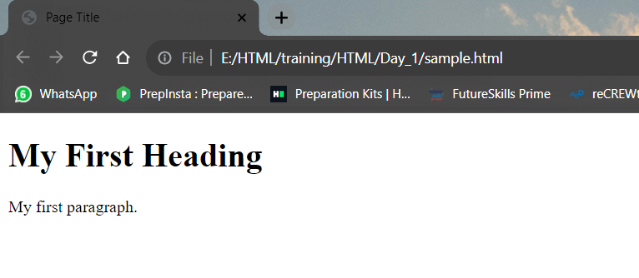
Sample.html
<!DOCTYPE html>
<html>
<head>
<title>Page Title</title>
</head>
<body>
<h1>My First Heading</h1>
<p>My first paragraph.</p>
</body>
</html>

Slide 8
Attributes
HTML attributes provide additional information about HTML elements.
All HTML elements can have attributes
provide additional information about elements
are always specified in the start tag
Attributes usually come in name/value pairs like: name="value"

Slide 9
Attribute
The href Attribute.
The <a> tag defines a hyperlink. The href attribute specifies the URL of the page the link goes to:
The src Attribute
The <img> tag is used to embed an image in an HTML page. The src attribute specifies the path to the image to be display
..\Day_1
Attribute.html

Slide 10
Page Title
Every web page should have a page title to describe the content and meaning of the page.
The <title> element:
defines a title in the browser toolbar
provides a title for the page
displays a title for the page
Syntax
<title> Title name </title>

Slide 11
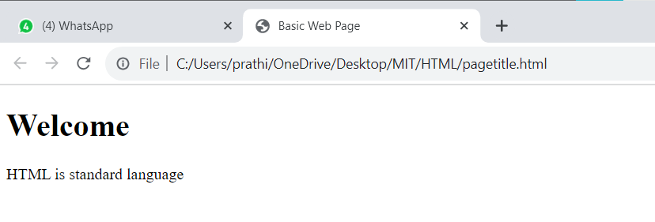
EXAMPLE:
<!DOCTYPE html>
<html>
<head>
<title>Basic Web Page</title>
</head>
<body>
<h1>Welcome</h1>
<p>HTML is standard language
</body>
</html>

Slide 12
Headings
HTML headings are titles or subtitles that you want to display on a webpage.
HTML headings are defined with the <h1> to <h6> tags.
<h1> defines the most important heading. <h6> defines the least important heading.
..\Day_1
heading.html

Slide 13
Paragraphs
A paragraph always starts on a new line, and is usually a block of text.
The HTML <p> element defines a paragraph.
A paragraph always starts on a new line, and browsers automatically add some white space (a margin) before and after a paragraph.
Horizontal Rules
The <hr> tag defines a thematic break in an HTML page, and is most often displayed as a horizontal rule.
The <hr> element is used to separate content (or define a change) in an HTML page:
Line Breaks
The HTML <br> element defines a line break.
Use <br> if you want a line break (a new line) without starting a new paragraph:

Slide 14
Poem Problem
The HTML <pre> element defines preformatted text.
The text inside a <pre> element is displayed in a fixed-width font (usually Courier), and it preserves both spaces and line breaks:
..\Day_1
Paragraphs.html

Slide 15
Styles
The HTML style attribute is used to add styles to an element, such as color, font, size, and more.
Syntax
<tagname style="property:value;">
Background Color
The CSS background-color property defines the background color for an HTML element.
Text Color
The CSS color property defines the text color for an HTML element:

Slide 16
Fonts
The CSS font-family property defines the font to be used for an HTML elements
Text Size
The CSS font-size property defines the text size for an HTML element:
Text Alignment
The CSS text-align property defines the horizontal text alignment for an HTML element:
..\Day_1
style.html

Slide 17
Text Formatting
HTML contains several elements for defining text with a special meaning.
<b> - Bold text
<strong> - Important text
<i> - Italic text
<em> - Emphasized text
<mark> - Marked text
<small> - Smaller text ..\Day_1
<del> - Deleted text text_formating.html
<ins> - Inserted text
<sub> - Subscript text
<sup> - Superscript text

Slide 18
Comments
HTML comments are not displayed in the browser, but they can help document your HTML source code.
Syntax
<!-- Write your comments here -->

Slide 19
Colors
HTML colors are specified with predefined color names, or with RGB, HEX, HSL, RGBA, or HSLA values.
RGB and RGBA Colors
In HTML, a color can be specified as an RGB value, using this formula:
rgb(red, green, blue)
Each parameter (red, green, and blue) defines the intensity of the color with a value between 0 and 255.
This means that there are 256 x 256 x 256

Slide 20
HEX Colors
A hexadecimal color is specified with: #RRGGBB, where the RR (red), GG (green) and BB (blue) hexadecimal integers specify the components of the color.
In HTML, a color can be specified using a hexadecimal value in the form:
#rrggbb
Where rr (red), gg (green) and bb (blue) are hexadecimal values between 00 and ff (same as decimal 0-255).
..\Day_1
color.html

Slide 21
Links - Hyperlinks
HTML links are hyperlinks.
You can click on a link and jump to another document.
When you move the mouse over a link, the mouse arrow will turn into a little hand.
The HTML <a> tag defines a hyperlink. It has the following syntax:
Syntax
<a href="url">link text</a>
The most important attribute of the <a> element is the href attribute, which indicates the link's destination.
The link text is the part that will be visible to the reader.

Slide 22
The target Attribute
By default, the linked page will be displayed in the current browser window. To change this, you must specify another target for the link.
The target attribute specifies where to open the linked document.
The target attribute can have one of the following values:
_self - Default. Opens the document in the same window/tab as it was clicked
_blank - Opens the document in a new window or tab
_parent - Opens the document in the parent frame
_top - Opens the document in the full body of the window
Use an Image as a Link
To use an image as a link, just put the <img> tag inside the <a> tag:
Link to an Email Address
Use mailto: inside the href attribute to create a link that opens the user's email program (to let them send a new email):

Slide 23
Button as a Link
To use an HTML button as a link, you have to add some JavaScript code.
JavaScript allows you to specify what happens at certain events, such as a click of a button:
Link Titles
The title attribute specifies extra information about an element. The information is most often shown as a tooltip text when the mouse moves over the element.
..\Day_1
hyperlinks.html
hyperlink_color.html

Slide 24
Images
The HTML <img> tag is used to embed an image in a web page.
Images are not technically inserted into a web page; images are linked to web pages. The <img> tag creates a holding space for the referenced image.
The <img> tag is empty, it contains attributes only, and does not have a closing tag.
The <img> tag has two required attributes:
src - Specifies the path to the image
alt - Specifies an alternate text for the image
Image Floating
Use the CSS float property to let the image float to the right or to the left of a text:
Images.html

